Slide 1
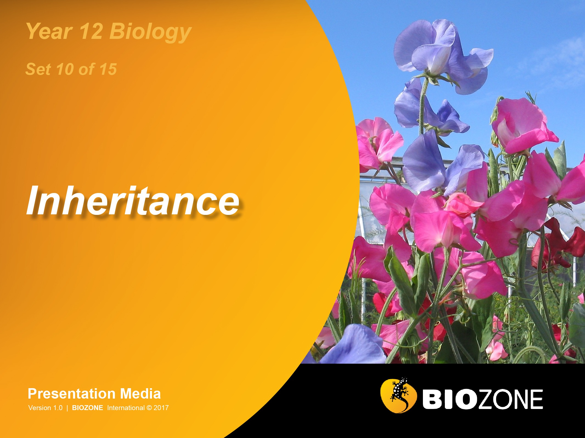

Slide 2
Variation
Sources of variation
Phenotypes
Mutations
Non-disjunction
Aneuploidy
Mendelian Genetics
Gregor Mendel
Mendel’s pea experiments
Mendel’s laws
Alleles
Monohybrid crosses
Dihybrid crosses
Non-Mendelian genetics
Linked genes
Mitochondrial DNA
DNA methylation
Sex chromosomes
Sex determination
Sex linkage
Polygeny
Pedigree analysis

Slide 3
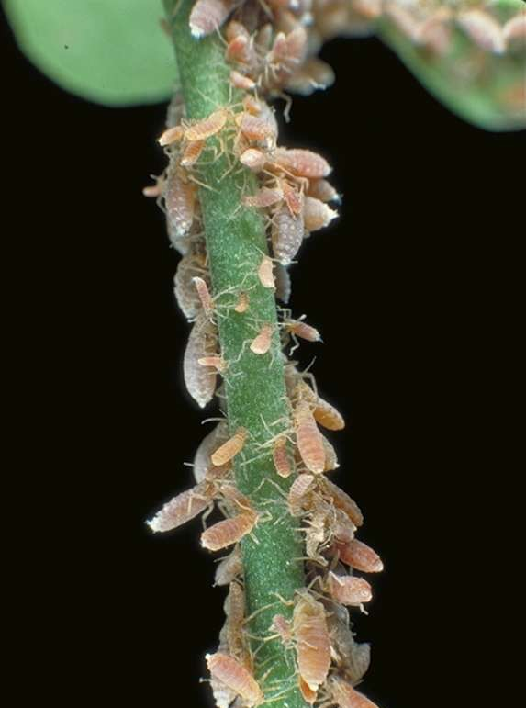
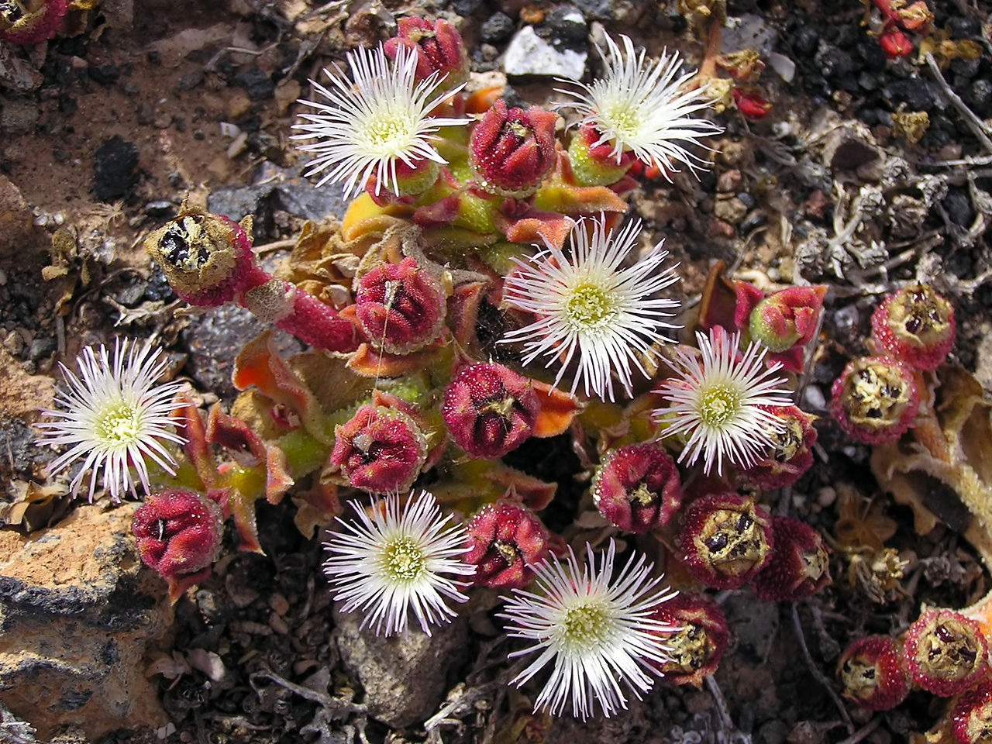
Sources of Variation
Variation refers to the diversity of genetic and phenotypic traits within and between populations.
Variation is a feature of sexually reproducing populations and it is the essential raw material for selection. Variation gives species greater opportunity to adapt to and survive in a dynamic environment.
Populations of highly variable species will include individuals with different fitness in the prevailing environment. It is this variability that offers the chance of reproductive advantage if environments change.
Species with low variability (such as populations of clones) can be highly successful in stable conditions, but will reproduce sexually when environments become unfavourable for just this reason.
Phenotype is influenced by both genotype and the environment. Even organisms of fixed genotype may differ in how much their phenotype can change in response to environment (a phenomenon known as phenotypic plasticity).
These aphids are clones
Mesembryanthemum (ice plants) show phenotypic plasticity nn their use of water

Slide 4
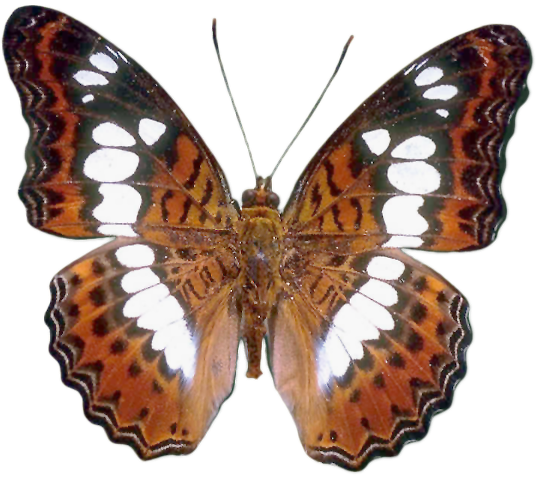
Sources of Variation
Mutations
gene mutations, chromosome mutations
Mutations are the source of all new alleles. Existing genes are modified by base substitutions and deletions, causing the formation of new alleles. Silent mutations may escape selection pressure until conditions change.
Sexual reproduction
independent assortment, crossing over and recombination, mate selection
Sexual reproduction rearranges and reshuffles the genetic material into new combinations.
Phenotype
An individual’s phenotype is the result of the interaction of genetic and environmental factors during its lifetime (including during development). The genetic instructions for creating the individual may be modified by the internal and external environment both during and after development. Phenotypic plasticity in response to environment can be adaptive if it increases fitness.
Genotype
Determines the genetic potential of an individual
Environmental factors
The external and internal environments can influence the expression of the genotype. The external environment may include physical factors such as temperature or light intensity, or biotic factors such as competition. The internal environment, e.g presence or absence of hormones or growth factors during development, may also affect genotypic expression.

Slide 5
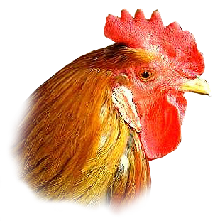
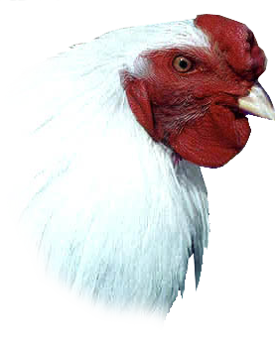
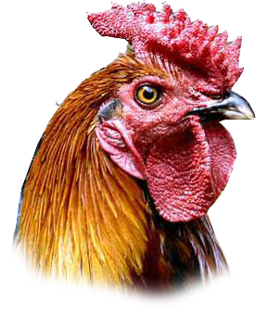
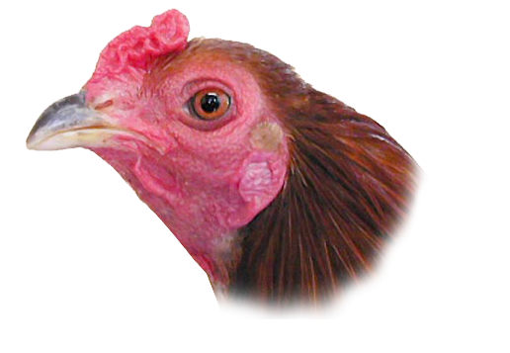
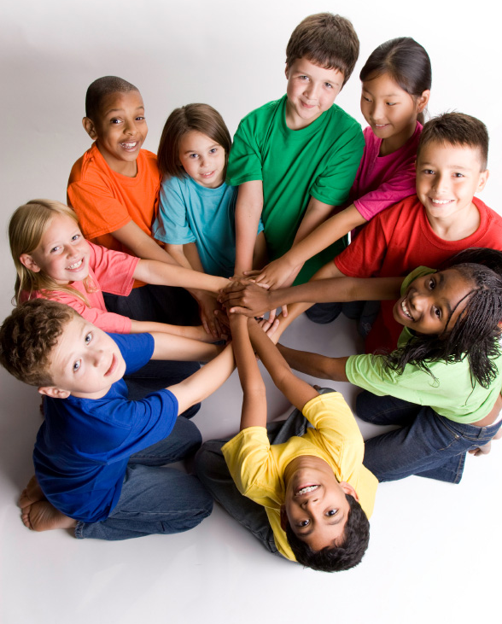
Qualitative and Quantitative
Comb shape in poultry is a qualitative trait and birds have one of four phenotypes depending on which combination of four alleles they inherit.
Quantitative traits are characterised by continuous variation, with individuals falling somewhere on a normal distribution curve of the phenotypic range.
Typical examples include skin colour and height in humans grain yield in corn growth in pigs and milk production in cattle.
Quantitative traits are determined by genes at many loci (polygenic) but most are also influenced by environmental factors.
Chicken combs are a qualitative trait
iStock
Skin colour is a quantitative trait

Slide 6

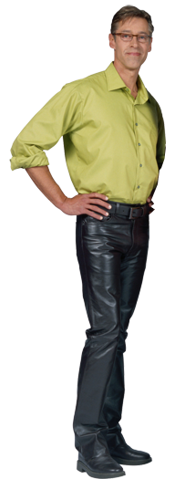
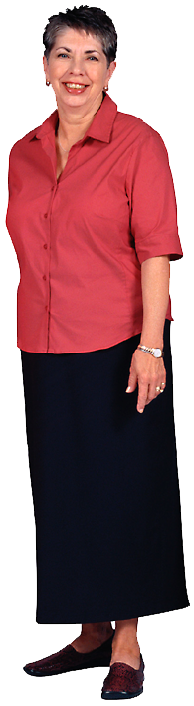

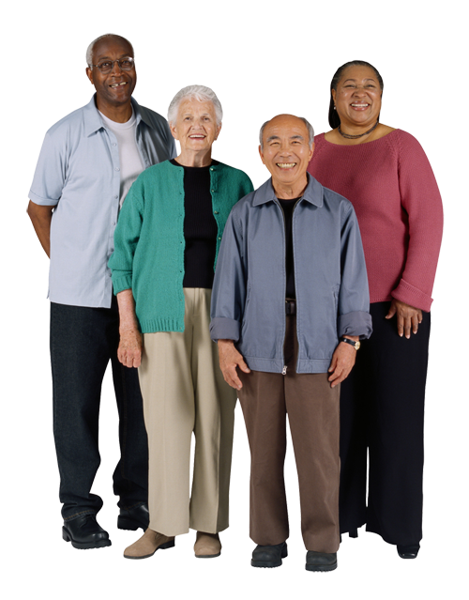
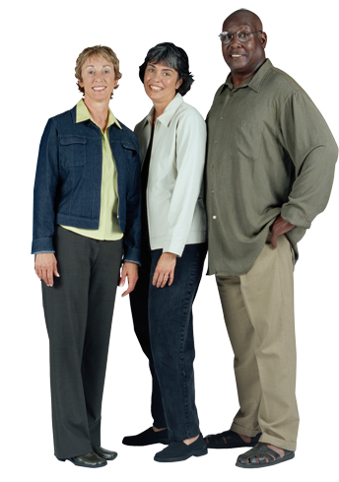

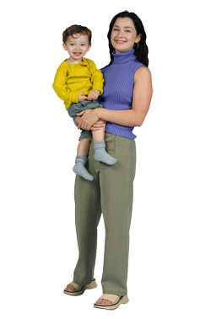

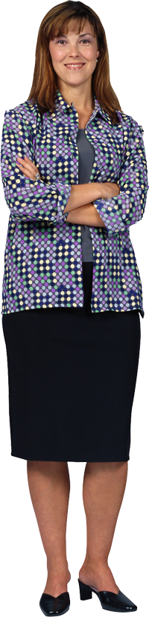
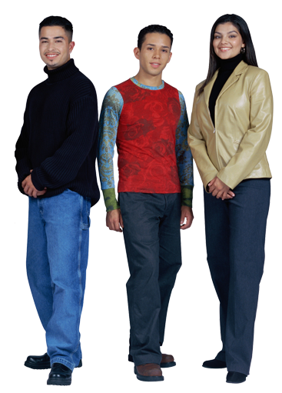
Phenotype
The phenotype is a combination of:
The genes that are expressed.
All the environmental influences from the moment that the egg is fertilised.
Environment contributes most obviously to the phenotypic range of characteristics for which there is no rigidly defined phenotype associated with a particular genotype, e.g. skin colour.

Slide 7
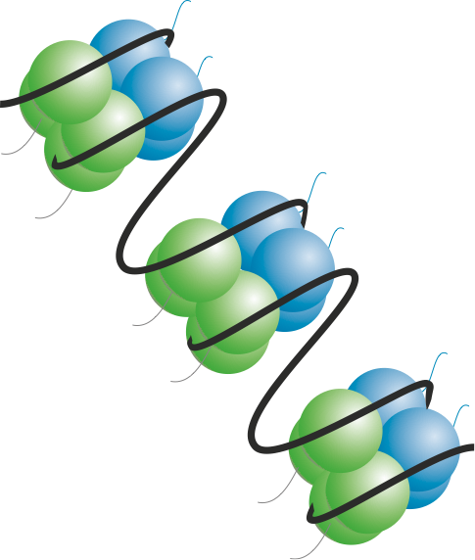
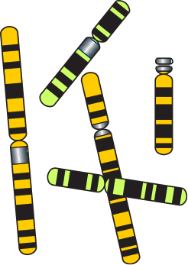
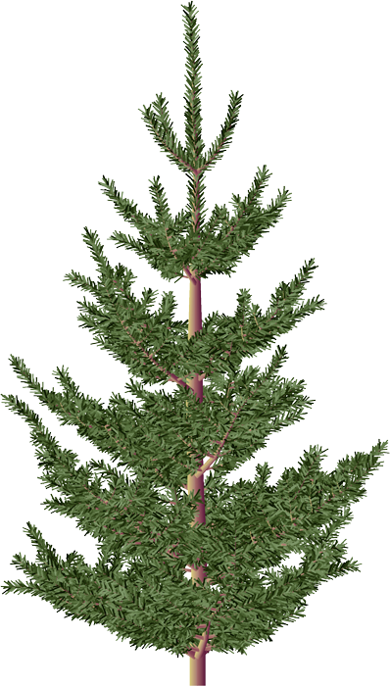
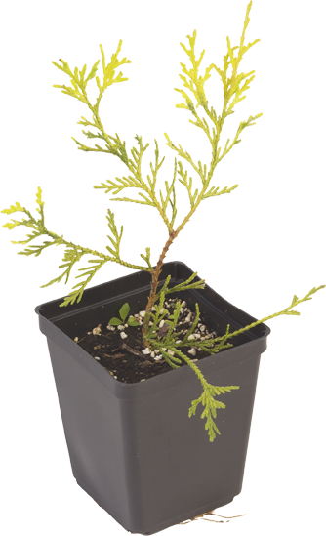
Influences on Phenotype
Epigenetics
Source of
genetic variation
Genotype
Histone modification
DNA methylation
Dominant alleles
Recessive alleles
Mutations
Crossing over
Independent assortment
Gene interactions
Influenced by the environment
Combine in their effects
Provides
inherited variation
Source of
environmentally induced variation
Wind Water availability
Acidity
Temperature
Soil type
Light
Predation
Provides
non-inherited variation
Phenotype
Environment
The resulting phenotype is the product of the effects of the environment on genetic potential

Slide 8
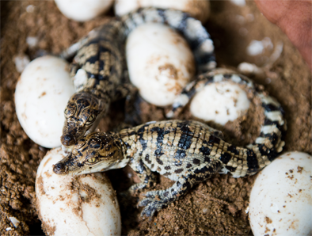
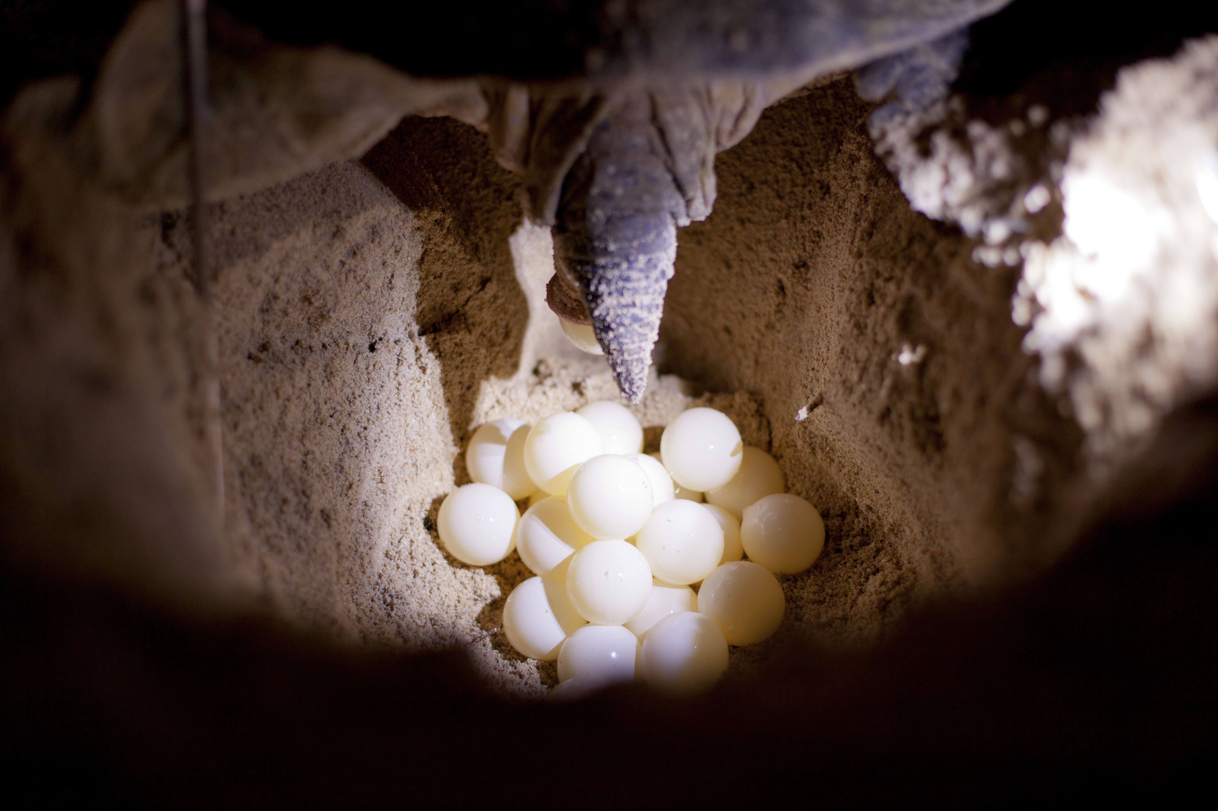
Temperature Effects on Phenotype
Sex determination
The sex of some animals is determined by the temperature at which they were incubated during embryonic development.
Examples include American alligators, crocodiles, and turtles.
In some species:
High incubation temperatures produce males and low incubation temperatures produce females.
In other species the opposite is true.
Photos: DPC
Sex in crocodiles (top) and green turtles (bottom) is determined by incubation temperature.

Slide 9
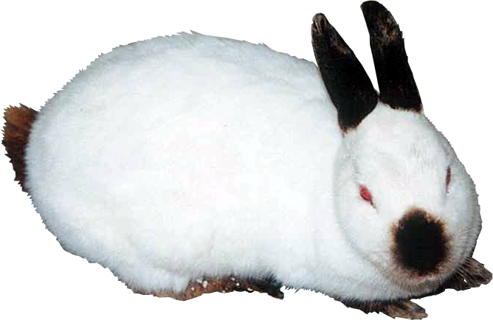
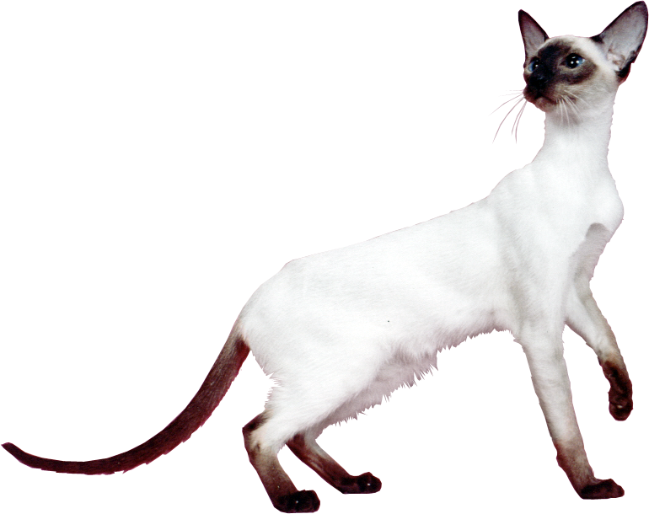
Temperature Effects on Phenotype
Colour pointing
Some breeds of cat and rabbit have distinctive darker fur on the extremities (called pointing).
Pigment production is controlled by a temperature sensitive enzyme and only the extremities are cool enough to allow the enzyme to function.
Examples include Siamese cats and Himalayan rabbits

Slide 10
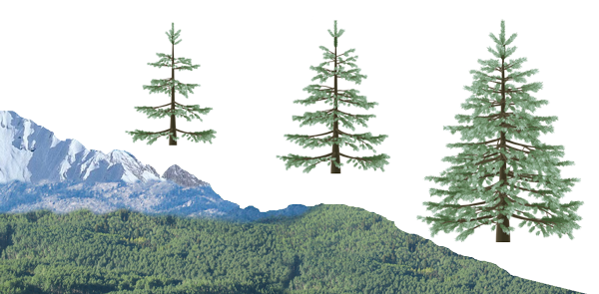
Altitude Effects on Phenotype
Plants of the same species produce a smaller or stunted phenotype with higher altitude.
Such patterns are observable in the vegetation growing on mountainsides.
This may be due to the combined effects of:
Wind exposure
Cooler temperatures
Water availability
Rarified atmosphere (low oxygen)
Large trees growing to full height of their genetic potential
Some stunting of growth due to environmental effects
Severe stunting near the snow line

Slide 11
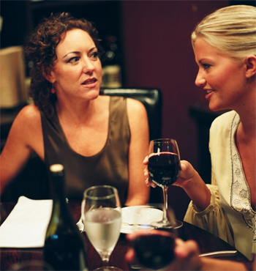
Chemical Effects on Phenotype
Harmful chemicals (called teratogens) can adversely affect phenotype.
There are many examples of babies born with deformities because of drugs or alcohol taken by the mother during pregnancy.
The sedative drug thalidomide was promoted as an anti-nausea drug in the 1960s. It was found to interfere with limb development, leading to babies with severe limb deformities.
Babies born to mothers who drink alcohol during pregnancy are at high risk of fetal alcohol syndrome. These babies have a suite of disorders including facial abnormalities and mental retardation.

Slide 12


Types of Mutation 1
Gene mutations
Genetic change affecting the base sequence of a single gene.
Gene mutations may result in the formation of a new allele.
Mutation: Substitute T instead of C
Original
DNA
Mutant DNA

Slide 13
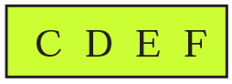
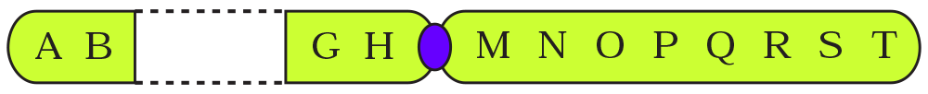
Types of Mutation 2
Chromosome mutations (also called block mutations)
Changes in the structure of a chromosome involving large pieces being rearranged.
Whole groups of genes are affected.
Chromosome segment is lost
Break
Break
Genes

Slide 14


Types of Mutation 3
Changes in chromosome number
Aneuploidy: The loss or gain of whole chromosomes.
Polyploidy: The loss or gain of complete sets of chromosomes.
21
The example above illustrates trisomy 21, a condition that is responsible for Down syndrome

Slide 15

Point Mutations 1
Gene mutations change the sequence of bases in DNA for a single gene. They may produce a new allele of a gene.
Gene mutations involving a single nucleotide are usually called point mutations.
The new DNA sequence may result in a new sequence of the amino acids constituting a protein.
Because of the degeneracy in the genetic code, not all changes in a DNA sequence will result in a new sequence of amino acids.
Even with a change in amino acid sequence, protein function may be unaffected (the mutation is silent).
Mutant DNA

Slide 16


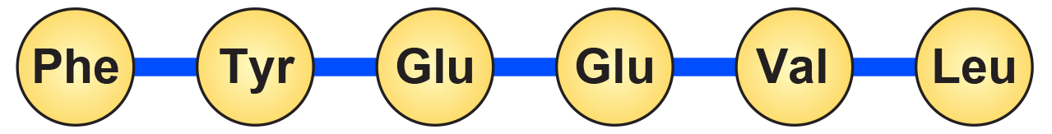
Point Mutations 2
As a reference for the following screens, the diagram below illustrates the transcription and translation of DNA without a point mutation.
Original unaltered code
Original DNA
Transcription
mRNA
Translation
Amino acids
Amino acid sequence forms a normal polypeptide chain

Slide 17

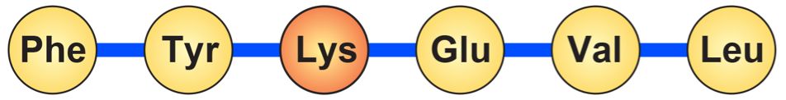
Missense Substitution
A single base is substituted with another, resulting in a codon that codes for a different amino acid.
Mutation: Substitute T instead of C
Original DNA
Mutant DNA
mRNA
Amino acids
Polypeptide chain with wrong amino acid

Slide 18


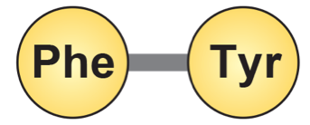
Nonsense Substitution
A single base is substituted by another.
This results in a new triplet that does not code for an amino acid.
The resulting triplet may be an instruction to terminate the synthesis of the polypeptide chain.
Mutation: Substitute A instead of C
Original DNA
Mutant DNA
mRNA
Amino acids
Mutated DNA creates a STOP codon which prematurely ends synthesis of the polypeptide chain

Slide 19


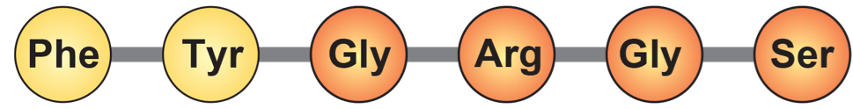
Reading Frame Shift by Insertion
A single base is inserted, upsetting the reading sequence for all those after it.
A reading frame shift results in new amino acids in the polypeptide chain from the point of insertion onwards.
The resulting protein will be grossly different from the one originally encoded (it is most likely to be non-functional).
Mutation: Insertion of C
Original DNA
Mutant DNA
mRNA
Large scale frame shift results in a new amino acid sequence. The resulting protein is unlikely to have any biological activity.
Amino acids

Slide 20


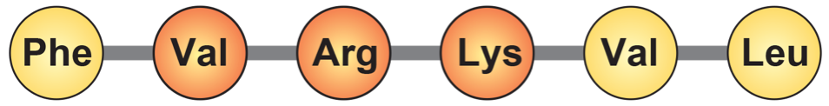
Partial Reading Frame Shift
A single base is inserted and another is deleted at a different location. This causes a localised frame shift.
The amino acid sequence between these points changes.
Depending on how many amino acids are affected, the resulting protein may have some biological activity.
Mutation: Insertion of C
Mutation: Deletion of C
Original DNA
Mutant DNA
mRNA
Altered chain which may or may not produce a protein with biological activity
Amino acids

Slide 21

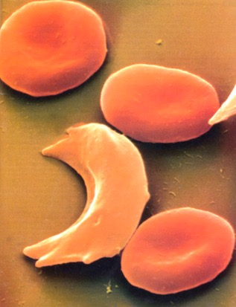
Sickle Cell Anemia
Synonym: Sickle cell disease
Incidence: Most common in people of African ancestry.
West Africans: 1% (10-45% are carriers)
West Indians: 0.5%
Gene type: Autosomal mutation (HBB) on chromosome 11 which results in the substitution of a single nucleotide in the HBB gene coding for the beta chain of haemoglobin.
The allele is codominant.
HBB
Gene location: Chromosome 11
p
q
Normal red blood cells
Sickle-cell
Photo Defiers.com

Slide 22
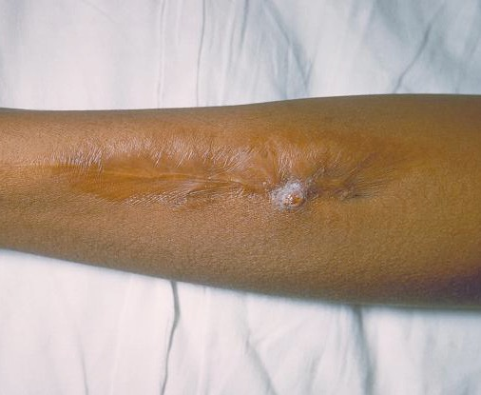
Sickle Cell Disease
Treatment and outlook:
Patients are given folic acid.
Acute episodes may require:
oxygen therapy
intravenous infusions of fluid
antibiotics to treat infection
Experimental therapies include bone marrow transplants and gene therapy.
(Photo CDC)
Sickle cell lesion

Slide 23
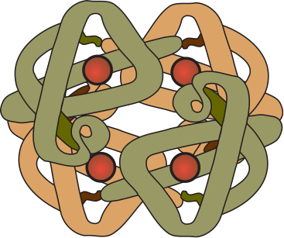
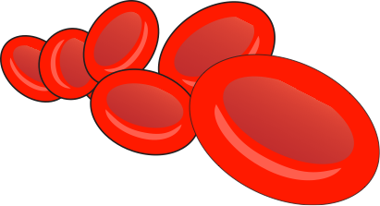

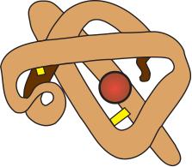

Sickle Cell Mutation
The mutation responsible for causing sickle cell disease is a point substitution.
Hemoglobin molecules
are made up of 2 α-chains and 2 β-chains linked together
Normal red blood cells
containing normal haemoglobin (soluble)
Sickle cells
containing mutant haemoglobin (less soluble)
Beta (β) chain
Alpha (α) chain
Red blood cells normally have a biconcave shape, which enables them to squeeze through capillaries.
When deprived of oxygen, haemoglobin precipitates to form fibres, which deform the red blood cells into a sickle shape.
β-Chain
hemoglobin
First base
Normal base: T
Substituted base: A
The sickle cell mutation involves the substitution of one base for another in the HBB gene, causing a single amino acid to be altered.
DNA
Codes for the 1st amino acid

Slide 24

Cystic Fibrosis
Cystic fibrosis (CF) is an example of a harmful mutation in humans.
Synonyms: Mucoviscidosis, CF
Incidence: Varies with populations:
People of Asian ethnicity: 1 in 10,000
People of European ethnicity: 1 in 20-28 are carriers
Mutation type: Autosomal recessive. Over 500 different recessive mutations of the CFTR gene have been identified:
deletions, missense, nonsense, terminator codon
p
q
CFTR
Gene location
Chromosome 7

Slide 25


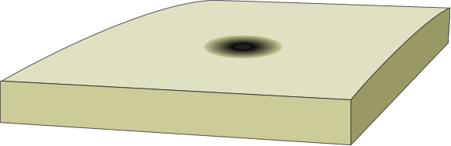
Cystic Fibrosis Mutation
The mutation causing 70% of cystic fibrosis cases is a gene mutation (delta F508) involving a net triplet deletion.
Base 1630
CFTR protein
Part of the DNA sequence in the CFTR gene
This triplet codes for the 500th amino acid
These three bases are deleted from the 507/508th triplets in the DF508 mutation
Cl-
Cl-
Cl-
Water
Cl-
Outside the cell
Outside the cell
Plasma membrane
Cell cytoplasm
Cell cytoplasm
Cl-
Cl-
Cl-
Cl-
Cl-
Cl-
Cl-
Normal CFTR protein
regulates chloride transport across the membrane
Mutant CFTR protein
cannot regulate chloride transport. Chloride ions remain in the cell and water enters the cell

Slide 26
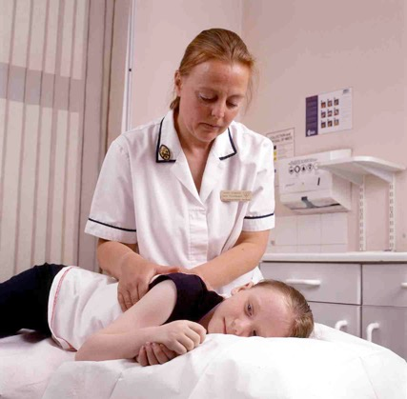
Cystic Fibrosis
Symptoms:
Infertility occurs in males and females.
Disruption of the following glands:
the pancreas
intestinal glands
biliary tree (biliary cirrhosis)
bronchial glands (chronic lung infections)
sweat glands (high salt content of which becomes depleted in hot environments)
Conventional treatment
Chest physiotherapy.
A modified diet.
Supplementary pancreatic enzymes.
The use of antibiotics to control lung infections.
Future treatments?
Gene therapy inserting normal CFTR gene using adenoviral vectors and liposomes.
(Photo: UK Cystic Fibrosis Gene Therapy Consortium)
A child with cystic fibrosis undergoing chest massage in order to expel mucus

Slide 27
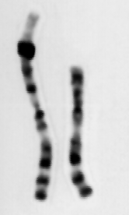
Causes of Block Mutations
Some block (chromosome) mutations occur as a result of errors in crossing over during meiosis.
Mutagens also cause block mutations.
Block mutations cause genetic imbalances which usually disrupt development. They can be described as:
Inversion: Pieces of chromosome are flipped so the genes appear in reverse order.
Translocation: Pieces of chromosome are moved from one chromosome into another.
Duplication: Pieces of chromosome are repeated so there are duplicate segments.
Deletion: Pieces of chromosome are lost.
Photo Cytogenetics Dept. Waikato Hospital

Slide 28
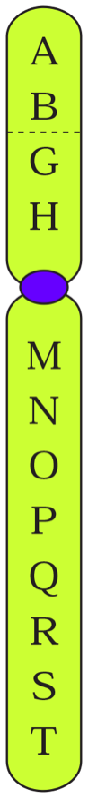
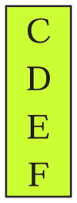
Block Mutations: Deletion
Break occurs at two points on the chromosome and the middle piece falls out.
The two ends rejoin to form a chromosome deficient in some genes.
Alternatively, the end of a chromosome may break off and be lost.
Chromosome
rejoins
Break
Break
Segment is lost
Genes
Step 1
Step 2
Step 3

Slide 29




Deletion Example
Human chromosome 1 shows two forms of deletion.
These may involve deletion of either a chromosome tip (left) or a middle segment with the tip rejoined (right).
Deletions involving small amounts of chromosomal material underlie several disorders, including:
Cri-du-chat syndrome
Prader-Willi syndrome
Angelman’s syndrome
Deletions of large amounts of chromosomal material are usually lethal.
Tip deletion
Mid-segment deletion
Before
After
Before
After
Tip
rejoins
1
1
Lost
Lost
1
1

Slide 30
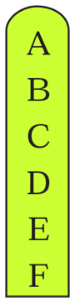


Block Mutations: Translocation
Translocation involves the movement of a group of genes between different chromosomes.
A piece of one chromosome breaks off and joins on to another chromosome.
The result is a chromosome deficient in genes and one with too many genes.
Segment removed
Segments join
Break
Genes
Step 1
Step 2
Step 3

Slide 31




Translocation Example
Translocation can occur between human chromosomes 9 and 22.
The tips of the two chromosomes are exchanged.
This is the translocation observed in chronic myeloid leukaemia.
Before translocation
After translocation
22
22
9
The tips of the chromosomes swap
9

Slide 32
Block Mutations: Inversion
The middle piece of the chromosome falls out, rotates through 180°, and then rejoins.
There is no loss of genetic material.
Break
Segment rejoins
Break
Segment rotates 180°
Genes
Step 1
Step 2
Step 3

Slide 33
Inversion Example
A segment of human chromosome 2 is inverted (caused by looping of the chromosome)
All inversions cause abnormalities during meiosis and affect the viability of the gametes produced.
However, if a combination of genes within an inversion is desirable, they can act as a supergene and can confer a selective advantage.
Normal
Inversion
Flip
2
2

Slide 34
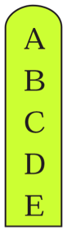
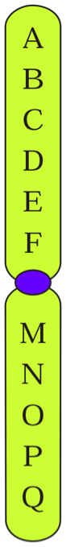
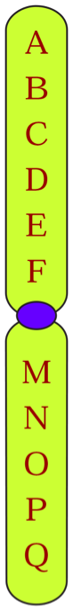
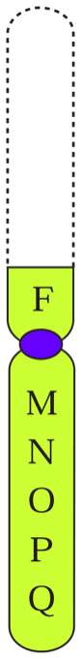
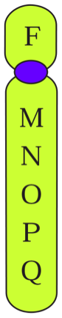
Block Mutations: Duplication
A segment is lost from one chromosome and is added to its homologue.
The chromosome on the left was the 'donor' of the duplicated piece of chromosome.
The chromosome with the duplication will become incorporated into a gamete, which may later contribute to an embryo.
Segment removed
Joins on to
homologous
chromosome
Break
Genes
Step 1
Step 2
Step 3

Slide 35


Duplication Example
A segment of human chromosome 9 is duplicated.
A segment is taken from its homologue and inserted to produce double copies of some genes.
Some genes may be disrupted.
Gene duplications can have evolutionary significance.
Example: The alpha and beta chains of haemoglobin arose following a duplication event 500 million years ago.
Normal
Duplication
Duplicate segment
A segment is transferred from one chromosome into its homologue
Identical segment
9
9

Slide 36
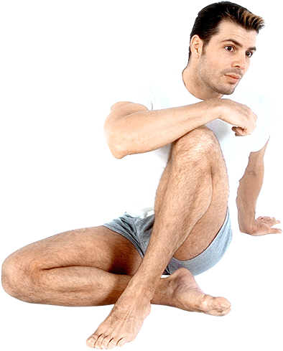


Gene Duplication
Studies have shown that gene duplication has occurred in virtually every species and often more than once.
It is well known that many important crop plants (e.g. wheat) have duplicated not just one gene, but their entire genome.
The duplication of a gene frees one of those genes to develop a new function, while the original continues as it was.
In the case of genes that produce proteins with a tendency or ability to perform two functions, there may be adaptive conflict, in which its ability to perform one function compromises its ability to perform another.
Gene duplication solves this problem by allowing natural selection to act on the genes so that they follow different evolutionary paths.
Homo sapiens: 38% genes duplicated
Drosophila melanogaster
(fruit fly): 41% genes duplicated
Caenorhabditis elegans
(nematode): 49% genes duplicated

Slide 37

Colobine Monkeys
Gene duplication in colobine monkeys has enabled the production of enzymes that optimally perform similar functions in different body environments.
The primary food source of colobines, unlike most other primates, is leaves. The leaves are fermented in the gut by bacteria, which are then digested with the assistance of an enzyme produced by RNase genes.
In colobines there are two forms of the RNase genes, RNase1 and RNase1B, while in other primates there is only RNase1.
The optimal pH for the enzyme RNase1 is 7.4. For RNase1B, the optimal pH is 6.3. In colobine monkeys, the pH of the digestive system is 6-7, but in other primates it is 7.4-8.
RNase1B is six times more efficient at degrading RNA in the gut of colobines than RNase1. RNase1 is also expressed in cells outside the digestive system where it degrades double stranded RNA and may assist in defense against viral infection. RNase1B is 300 times less efficient at this function.
Atamari CC 3.0

Slide 38

Antarctic Eel Pout
Fish living in the near freezing waters of the Antarctic must have a way of ensuring their blood remains ice free.
In many species, this is done by employing proteins with antifreeze properties. There are four major antifreeze proteins found in fish (labelled AFP types I - IV).
The gene for the protein AFP III, found in Antarctic eelpout, is very similar to the gene that produces sialic acid synthase (SAS).
Molecular studies have found that a slight modification in the SAS gene causes the production and secretion of AFP III. More importantly, the SAS gene also shows ice binding capabilities.
It appears that a duplication of the SAS gene produced a new gene that was selected for its ice binding capabilities and thus diverged to become the AFP III gene in Antarctic eelpout.
AFP III

Slide 39



Non-disjunction in Meiosis
The meiotic spindle normally distributes chromosomes to daughter cells without error. However, mistakes can occur during meiosis in which the chromosomes, or sister chromatids, fail to separate properly at anaphase.
This mishap is called non-disjunction. It can occur during meiosis I or meiosis II.
Non-disjunction results in abnormal numbers of chromosomes passing to the gametes.
If either of these aberrant gametes unites with a normal one at fertilisation, the offspring will have an abnormal chromosome number.
This is known as an aneuploidy, e.g. trisomy.
Photos: Cytogenetics Dept. Waikato Hospital
Trisomy 13
Trisomy 18
Trisomy 21

Slide 40



Non-Disjunction: Meiosis I
A non-disjunction in meiosis I occurs when homologous chromosomes fail to separate properly during anaphase I.
One gamete receives two of the same sort of chromosome and the other gamete receives no copy.
Non-disjunction
Meiosis I
Meiosis II
Gametes
n+1
n+1
n–1
n–1

Slide 41



Non-Disjunction: Meiosis II
A non-disjunction in meiosis II occurs when sister chromatids fail to separate properly during anaphase II.
One gamete receives two of the same sort of chromatid and the other gamete receives no copy.
Some gametes are unaffected.
Meiosis I
Meiosis II
Non-disjunction
Gametes
n+1
n–1
n
n

Slide 42



Faulty Sperm Production
Male
Female
Aneuploidy in human sex chromosomes may result from faulty sperm production.
This results from failure of the X and Y chromosomes to separate during meiosis (non-disjunction).
Primary spermatocyte
Mistake during meiosis
XY
XX
XY
X
X
Faulty gametes
XY
XY
X
X
X
X
Adobestock
Offspring
XXY
XO
XXY
XO
Klinefelter
syndrome
Turner
syndrome
Klinefelter
syndrome
Turner
syndrome

Slide 43
Faulty Egg Production
Male
Female
Aneuploidy in human sex chromosomes may result from faulty egg production.
This results from failure of the two X chromosomes to separate during meiosis (non-disjunction).
XY
XX
Primary
oocyte
X
Y
XX
Mistake
during
meiosis
X
X
Y
Y
XX
XX
Faulty gametes
Adobestock
XXX
XXY
XO
YO
Offspring
Metafemale
Klinefelter
syndrome
Turner
syndrome
Not viable

Slide 44


Aneuploidy in Sex Chromosomes
Unusual sex chromosome configurations can arise from mistakes made during gamete formation (failure of sex chromosomes to separate properly during meiosis).
XO, monosomic | Female | Turner syndrome
XX, disomic | Female | Normal female
XXX, trisomic | Female | Metafemale. Most appear normal; they have a greater tendency to criminality
XXXX, tetrasomic | Female | Rather like Down syndrome, with low fertility and intelligence
XY, disomic | Male | Normal male
XYY, trisomic | Male | Jacob syndrome. Apparently normal male, tall, aggressive.
XXY, trisomic | Male | Klinefelter syndrome. Incidence 1 in 10,000 live male births, with a maternal age effect.
XXXY, tetrasomic | Male | Extreme Klinefelter, mentally retarded.
Sex chromosomes and chromosome condition
Apparent sex
Phenotype

Slide 45

Barr Bodies in Aneuploidy
In human aneuploid syndromes, such as those described earlier, all but one of the X chromosomes are inactivated, regardless of the number present.
Barr body occurrence in various human karyotypes is represented right.
The total chromosome number is given first, and the inactive X chromosomes are represented by a dark green box.
Nucleus
Cytoplasm
Barr body lies against the nuclear envelope in interphase cells
Inactivated X is metabolically and genetically inert

Slide 46




Sex Aneuploidy Phenotypes
Four phenotypes of people with abnormal numbers of sex chromosomes (together with the normal male and female phenotypes):
Normal male
Jacob syndrome
Klinefelter syndrome
Turner syndrome
Metafemale
Normal female
XXX, XXXX, XXXXX
XY
XYY, XYYY
XXY, XXXY, XXXXY
XO
XX

Slide 47

Klinefelter Syndrome
Mildly impaired IQ (intelligence)
Chromosome complement: 47, XXY
Karyotype and phenotype:
Poor beard growth
Chest hair is sparse
Frequently some breast development (low levels of testosterone)
Osteoporosis
Penis and testes underdeveloped, low levels of testosterone. Always infertile.
Female type pubic hair pattern
Photo: Cytogenetics Dept. Waikato Hospital
Limbs tend to be longer than average
Sex chromosomes: XXY

Slide 48

Turner Syndrome
Chromosome complement: 45, X
Karyotype and phenotype:
Mental development normal. Difficulty with spatial memory.
Characteristic residual lateral web neck
Low posterior hair line
Constriction of aorta
Poor breast development
Elbow deformity
Degenerate ovaries (almost always infertile)
Photo: Cytogenetics Dept. Waikato Hospital
Puffy fingers with deep set, hyperconvex fingernails
Reduced stature (body is typically short)
Brown spots (nevi)
Sex chromosomes: XO

Slide 49

Gregor Mendel
Gregor Mendel (1822-1884) was an Austrian monk who is regarded as the father of genetics.
Mendel carried out pioneering work using pea plants to study the inheritance patterns of a number of traits (characteristics).
Mendel observed that characters could be masked in one generation of peas but could reappear in later generations.
What we now call Mendelian genetics is the study of inherited characteristics.
Photo: AT

Slide 50






Mendel’s Pea Experiments
Mendel examined a small number of traits in peas.
With one exception, each character he studied is determined by one gene, for which there are two alleles, one dominant and one recessive.
He found that these traits were inherited in predictable ratios depending on the phenotype of the parents.
Mendel’s results from crossing heterozygous plants produced remarkably consistent phenotypic ratios.
Seed colour
Yellow dominant over green
Pod colour
Green dominant over yellow
Pod shape
Inflated dominant over constricted
Seed shape
Round dominant over wrinkled
Images courtesy of Newbyte.com

Slide 51


Mendel’s Pea Experiments
Mendel examined seven phenotypic characters or traits in peas.
He found that these traits were inherited in predictable ratios depending on the phenotype of the parents.
Mendel’s results from crossing heterozygous plants produced remarkably consistent phenotypic ratios.
Stem length
Tall dominant over dwarf
Images courtesy of Newbyte.com

Slide 52


Mendel’s Pea Experiments
Terminal
Axial
Flower position
axial dominant over terminal
However, geneticists have since found that flower position is actually determined by two genes.
Images courtesy of Newbyte.com

Slide 53






Results of Mendel’s Experiments
Seed shape | Round | Wrinkled | 5474 1850 7324 | Round Wrinkled TOTAL | 2.96 : 1
Seed colour | Yellow | Green | 6022 2001 8023 | Yellow Green TOTAL | 3.01 : 1
Pod colour | Green | Yellow | 428 152 580 | Green Yellow TOTAL | 2.82 : 1
Flower position | Axial | Terminal | 651 207 858 | Axial Terminal TOTAL | 3.14 : 1
Pod shape | Inflated | Constricted | 882 299 1181 | Inflated Constricted TOTAL | 2.95 : 1
Stem length | Tall | Dwarf | 787 277 1064 | Tall Dwarf TOTAL | 2.84 : 1

Slide 54


Mendel’s View of Inheritance
Mendel observed that characters could be masked in one generation of peas but could reappear in later generations.
He showed that inheritance was particulate in its nature (not blending as was previously thought).
We now know these units of inheritance are genes.
Parent A
Parent B
Parent A
Parent B
Offspring
Old idea
Blending of parental traits
Offspring
New idea
Inherited traits behave as discrete units

Slide 55



Mendel’s Law of Segregation
Each pair of alleles is sorted into different gametes and subsequently into different offspring. This is the result of the way each allele is carried on separate homologous chromosomes that are separated during meiosis.
For any particular gene, an individual may be homozygous (i.e. AA or aa), or heterozygous (i.e. Aa).
Gametes contain only one copy of a gene since they only receive one chromosome from each homologous pair.
Homologous pair of chromosomes, each has a copy of the gene on it (A or a)
Oocyte
Meiosis
Gametes

Slide 56





Law of Independent Assortment
Oocyte
Genotype: AaBb
Alleles for different traits are sorted independently of each other.
All combinations of alleles are distributed to gametes with equal probability.
During meiosis, alleles on one pair of homologous chromosomes separate independently from allele pairs on other chromosomes.
These alleles will be inherited in the offspring in predictable ratios determined by the parental genotypes.
Intermediate
cells
Gametes
Ab
Ab
aB
aB

Slide 57




Law of Independent Assortment
Alleles for different traits are sorted independently of each other.
There are therefore two different ways the chromosomes from the previous slide can combine, resulting in four possible genotypes.
Oocyte
Oocyte
Genotype: AaBb
Intermediate cells
Gametes
Ab
Ab
aB
aB
AB
AB
ab
ab

Slide 58


Homologous Chromosomes
This diagram illustrates the complete chromosome complement for a hypothetical organism.
It has a total of ten chromosomes, comprising five nearly identical pairs (each pair is numbered).
Paternal chromosome that originated from the sperm of this individual's father.
Maternal chromosome that originated from the egg of this individual's mother.

Slide 59


Alleles
Genes occupying the same position (locus) on homologous chromosomes are called alleles.
Genes code for phenotypic characteristics. e.g. pod colour.
Alleles are versions of the same gene that code for a variant of that phenotypic characteristic (called a trait), e.g. green pod.
In a diploid organism, one individual can only have a maximum of two alleles for a given gene.
However, there may be more than two alleles for a gene in a population, e.g. blood groups A, B, O.
Some traits (e.g. height) may be determined by alleles at many loci.
Gene A
Genes that occupy the same locus code for the same characteristic.
Gene B
Gene C
Maternal chromosome
Paternal chromosome
Pod colour in peas is a characteristic controlled by a single gene. The allele for green pods is dominant over the allele for yellow pods.

Slide 60
Alleles
These two different versions of gene A (Aa) create a condition known as heterozygous. Only the dominant allele (A) will be expressed.
When both chromosomes have identical copies of the dominant allele for a gene, (in this case BB) the organism is said to be homozygous dominant for that gene.
When both chromosomes have identical copies of the recessive allele for a gene, (in this case cc) the organism is said to be homozygous recessive for that gene.
Genes occupying the same locus or position on a chromosome code for the same characteristic and called alleles.
Maternal chromosome that originated from the egg of this person's mother.
Paternal chromosome that originated from the sperm of this person's father.

Slide 61


Monohybrid Cross
Homozygous purple
Homozygous white
A monohybrid cross examines the inheritance of one trait, e.g. the inheritance of flower colour in peas.
The F1 offspring of a cross between two true breeding parent plants are all purple (Pp).
Note: F1 notation is usually used to denote the heterozygous offspring of true breeding parents.
A cross between these offspring (Pp x Pp) would yield a 3:1 ratio in the F2 generation.
P
X
PP
pp
P
P
Gametes
p
p
F1
Pp
Pp
Pp
Pp
P
p
Gametes
P
p
F2
PP
Pp
Pp
pp
3 purple (PP, Pp, Pp); 1 white (pp)

Slide 62


Test Cross and Backcross
Dominant phenotype
with unknown genotype
Recessive phenotype
with known genotype
An individual with the dominant phenotype may be homozygous dominant or heterozygous.
The genotype of individuals with the dominant phenotype can be established by carrying out a test cross (right) which the unknown genotype is crossed with a homozygous recessive.
The results of a test cross are definitive in that the unknown genotype will be revealed.
Where an individual is crossed with one of its parents, it is referred to as a back cross.
RR or Rr
X
If unknown genotype is RR, then all of the offspring should be red.
If unknown genotype is Rr,
then 50% of offspring should be red and 50% white.
r
r
r
r
R
R
R
r
All Rr
50% Rr, 50% rr

Slide 63


Monohybrid Cross 1
In this example, the parents have different phenotypes for coat colour: black and white.
The two parents are true- breeding (i.e. homozygous) for this characteristic:
Homozygous black is true-breeding for black.
Homozygous white is true breeding for white.
The offspring will all be the black phenotype.
The offspring will all be heterozygous and carriers for the recessive white allele.
Homozygous white
Homozygous black
bb
BB
X
P
Possible fertilisations
Gametes
b
b
B
B
Bb
Bb
Bb
Bb
F1
Heterozygous black
The F1 refers to the heterozygous offspring of true-breeding parents

Slide 64
Monohybrid Cross 2
Here, the parents have the same black phenotype for coat colour.
Both parents are true-breeding (i.e. homozygous) for this characteristic.
The offspring will all be the black phenotype.
The offspring will all be the same phenotype and genotype as the parents: black homozygotes
Homozygous black
Homozygous black
BB
X
BB
P
Possible fertilisations
Gametes
B
B
B
B
BB
BB
BB
BB
Homozygous black offspring

Slide 65
Monohybrid Cross 3
Here, the parents have the same white phenotype for coat colour.
Both parents are true-breeding (i.e. homozygous) for this characteristic.
The offspring will all be the white phenotype.
The offspring will all be the same phenotype and genotype as the parents: white homozygotes.
Homozygous white
Homozygous white
bb
X
bb
P
Possible fertilisations
Gametes
b
b
b
b
bb
bb
bb
bb
Homozygous white offspring

Slide 66
Monohybrid Cross 4
In this cross, the parents have different phenotypes for coat colour: black and white.
One is true-breeding (homozygous)for white.
One is heterozygous for the black coat colour.
Half of the offspring will be black and half will be white.
The black offspring will be heterozygous and carry the recessive white allele.
Homozygous white
Heterozygous black
bb
X
Bb
P
Possible fertilisations
Gametes
b
b
B
b
Bb
bb
Bb
bb
Half homozygous white offspring and half heterozygous black

Slide 67
Monohybrid Cross 5
Here, the parents have the same black phenotype for coat colour.
One is heterozygous for the black coat colour and a carrier for the recessive white allele.
One is true-breeding (homozygous) for black.
The offspring will all be the same black phenotype.
Homozygous and heterozygous genotypes will be produced in a 1:1 ratio.
Heterozygous black
Homozygous black
Bb
X
BB
P
Possible fertilisations
Gametes
B
b
B
B
BB
BB
Bb
Bb
All offspring are black, with homozygotes and heterozygotes in equal proportions

Slide 68


Monohybrid Cross 6
Here, the parents have the same black phenotype for coat colour.
Both are heterozygous for black coat colour and carry the recessive white allele.
The offspring will be produced in the phenotypic ratio: 3 black and 1 white.
The genotype ratios will be:
Heterozygous black
Heterozygous black
Bb
X
Bb
P
Possible fertilisations
Gametes
B
b
B
b
1 BB : 2 Bb : 1 bb
BB
Bb
Bb
bb
3 : 1 phenotypic ratio
1 : 2 : 2 genotypic ratio

Slide 69




Codominance
In cases of codominance, both alleles are independently and equally expressed in the heterozygote. Examples include:
Roan (stippled red and white) coat colour in cattle. A cross between a red bull and a white cow produces all roan offspring.
ABO human blood groups.
Red bull
White cow
Parents
C^{R}C^{R}
C^{W}C^{W}
X
Gametes
C^{R}
C^{R}
C^{W}
C^{W}
Possible fertilizations
C^{R}C^{W}
C^{R}C^{W}
C^{R}C^{W}
C^{R}C^{W}
F1 offspring
Roan
Roan
Roan
Roan

Slide 70


Codominance in Cattle
In a cross between two heterozygous (roan) shorthorn cattle, red, roan, and white offspring are produced in a 1:2:1 ratio.
Roan bull
Roan cow
C^{R}C^{W}
C^{R}C^{W}
Parents
X
Gametes
C^{R}
C^{W}
C^{R}
C^{W}
Possible fertilizations
C^{R}C^{R}
C^{R}C^{W}
C^{R}C^{W}
C^{W}C^{W}
Offspring
Red
Roan
Roan
White

Slide 71
Codominance in Cattle
In examples of codominance where a true breeding red or white parent is crossed with a roan parent, the offspring will occur in a 1 : 1 ratio of the parental types (i.e. roan and red, or roan and white)
Red bull
Roan cow
C^{R}C^{R}
C^{R}C^{W}
Parents
X
Gametes
C^{R}
C^{R}
C^{R}
C^{W}
Possible fertilizations
C^{R}C^{R}
C^{R}C^{W}
C^{R}C^{R}
C^{R}C^{W}
Offspring
Red
Roan
Red
Roan

Slide 72

Multiple Alleles in Blood
The four common blood groups of the human ABO blood group system are determined by three alleles: A, B, and O. This is an example of a multiple allele system for a gene.
ABO antigens consist of sugars attached to the red blood cell surface. These sugars provide the individual antigenic properties. The alleles code for enzymes that join these sugars together.
Allele i produces a non-functional enzyme that is unable to make changes to the basic antigen (sugar) molecule.
The other two alleles (A, B) each produce a different enzyme that adds a different, specific sugar to the basic antigen.
Any one individual possesses only two alleles and they are expressed equally.
RBC
RBC
CDC Janice Carr

Slide 73
Multiple Alleles in Blood
Phenotype (blood group) | Genotypes | Allele codes for molecule |  | Antigen | Antibodies in serum
O | OO | Precursor | Precursor antigen without extra sugar at end | None (also called universal donor)
A | AA, AO |  | acetyl- galactosamine added to precursor
B | BB, BO |  | galactose added to precursor
AB | AB |  | Contains both sugars |  | None (also called universal recipient)

Slide 74


Multiple Alleles in Blood
EXAMPLE 1: For both parents with AB blood type, half of the offspring will be the same as the parents (AB), one quarter will be type A and one quarter will be type B.
Blood group: AB
Blood group: AB
Parent genotypes
AB
X
AB
Gametes
A
B
A
B
Possible fertilisations
Children's
genotypes
AA
AB
AB
BB
Blood groups
A
AB
AB
B

Slide 75


Multiple Alleles in Blood
EXAMPLE 2: Two parents with blood groups A and B respectively, may produce offspring with all four possible blood groups: AB, A, B and O.
This may only occur if both parents are carrying the allele for group O.
Blood group: B
Blood group: A
Parent genotypes
BO
X
AO
Gametes
B
O
A
O
Possible fertilisations
Children's' genotypes
AB
BO
AO
OO
Blood groups
AB
B
A
O

Slide 76





Dihybrid Crosses
Inflated, yellow pod
Constricted, green pod
Parents
P
IIgg
X
iiGG
A dihybrid cross studies the inheritance patterns of two genes.
Simple dihybrid crosses assume that the genes described are carried on separate chromosomes and assort independently during meiosis (there is no linkage).
F1
IiGg
X
IiGg
First filial
Second filial:
F2
IIGG
IiGG
IiGg
IIGg
Contains a dominant allele for each of the two genes – will show dominant phenotype for each gene.
Inflated, green pod
Inflated, yellow pod
IIgg
Iigg
Contains a dominant
allele for only gene I.
constricted, green pod
iiGG
iiGg
Contains a dominant
allele for only gene G.
constricted, yellow pod
Contains only
recessive alleles.
iigg
Genotypes are grouped into offspring with the same phenotype.

Slide 77

Dihybrid Cross Explained
Homozygous yellow-round
Homozygous green-wrinkled
Parents
X
Gametes
YR
yr
F1
All yellow-round
YyRr
X
YyRr
Offspring F2
Female gametes
9: Yellow-round
Possible fertilisations
YR
Yr
yR
yr
3: Green-round
YR
3: Yellow-wrinkled
Yr
1: Green-wrinkled
Male Gametes
yR
yr

Slide 78

Dihybrid Cross 1
In the example below, the characters involved are coat colour and coat length in guinea pigs. The alleles for short hair and black colour are dominant.
The parental types are homozygous and produce only one type of gamete for each trait.
The F1 offspring are all heterozygotes.
Homozygous black, short
Homozygous white, long
BBLL
X
bbll
P
BL
Possible fertilisations
bl
Gametes
Only one type of gamete is produced from each parent.
BbLl
X
BbLl
As there is only one kind of gamete from each parent, there is only one kind of offspring produced in the first generation: heterozygous black, short hair.

Slide 79


Dihybrid Cross 2
If the F1 heterozygotes from the previous example are crossed with each other four kinds of gamete are produced: BL, BI, bL, bl.
A Punnett square displays the expected ratio of the offspring genotypes and phenotypes. The offspring are produced in an expected 9 : 3 : 3 : 1 ratio.
Female gametes
Possible fertilisations
BL
Bl
bL
bl
Offspring (F2)
BL
Each of the 16 animals shown here represents the possible zygotes formed by different combinations of gametes coming together at fertilisation.
BBLL
BBLl
BbLL
BbLl
Bl
BBLl
BBll
BbLl
Bbll
Male gametes
bL
BbLl
BbLl
bbLL
bbLl
bl
BbLl
Bbll
bbLl
bbll

Slide 80
Dihybrid Cross 3
The offspring F2 will be produced in a 9:3:3:1 phenotype ratio:
Genotype
Phenotype
The offspring are arranged in phenotypic groups.
1 BBLL
2 BbLL
2 BBLl
4 BbLl
9 Black and short hair
A total of 9 offspring with one of four different genotypes can produce black, short hair.
9 black, short
3 Black and long hair
1 BBll
2 Bbll
A total of 3 offspring with one of two different genotypes can produce black, long hair.
3 black, long
3 White and short hair
1 bbLL
2 bbLl
A total of 3 offspring with one of two different genotypes can produce white, short hair.
3 white, short
1 White and long hair
1 bbll
Only 1 offspring of a given genotype can produce white, long hair.
1 white, long

Slide 81


Dihybrid Cross Exercise
Homozygous white, short hair
Heterozygous black, homozygous long hair
bbLL
Bbll
For these two guinea pig parents, determine:
All possible gametes produced by each parent for the genes of interest.
All possible genotypes and phenotypes in the offspring.
In this case, the results of the cross are revealed without completing all 16 crossings (grey rectangle).
Parents
Gametes
bL
bL
bL
bL
Bl
Bl
bl
bl
One kind of gamete
Two kinds of gametes
Offspring
Female gametes
Possible fertilisations
Bl
Bl
bl
bl
bL
BbLl
BbLl
bbLl
bbLl
Parental gametes
White parent gametes: bL
Black parent gametes: Bl, bL
Offspring
50% black short (BbLl)
50% white short (bbLl)
bL
BbLl
BbLl
bbLl
bbLl
Male gametes
bL
BbLl
BbLl
bbLl
bbLl
bL
BbLl
BbLl
bbLl
bbLl

Slide 82



Linked Genes
One homologous pair of chromosomes
Genes on the same chromosome are said to be linked. They are inherited together as a unit and do not undergo independent assortment.
Linkage can alter expected genotype and phenotype ratios in the offspring.
In this example, only two types of gamete are produced instead of the expected four kinds if the genes were assorted independently.
Oocyte
Meiosis
Gametes
Ab
Ab
aB
aB
Genes A and B control different traits and are on the same chromosome.

Slide 83



Linked Genes 1
Genes located on the same chromosome are said to be linked (e.g. genes A and B).
Tightly linked genes tend to be inherited together.
Linkage results in fewer genetic combinations of alleles in offspring (compared to genes on separate chromosomes).
In describing linkage, the appropriate notation shows a horizontal line separating linkage groups.
Parent 1 (2N)
Parent 2 (2N)
AB
ab
Linked
ab
ab
Linked
Two genes are linked when they are on the same chromosome
Line indicates linkage
Chromosome pair before replication
Chromosomes after replication

Slide 84






Linked Genes 2
The inheritance patterns involving linked genes do not follow expected Mendelian ratios.
In this example of linked genes, only two kinds of genotype combinations occur in the offspring.
Without linkage, the same parents would provide four possible genotypes: AaBb, Aabb, aaBb, aabb.
Chromosomes after replication
X
Meiosis
Gametes (N)
Only one gamete from each replicated chromosome is shown
Possible offspring
Only two genotype combinations occur
AaBb
AaBb
aabb
aabb

Slide 85




Linked Genes in Drosophila 1
The genes for wing shape (straight or curled) and body colour (grey or ebony) are on the same chromosome and are inherited together:
Inheritance of linked genes in Drosophila
The genes for wing shape and body colour are linked (they are on the same chromosome).
Parent
Wild type female
Mutant male
Phenotype
Straight wing
Grey body
Curled wing
Ebony body
Genotype
Cucu Ebeb
cucu ebeb
Linkage notation
Cu Eb
cu eb
cu eb
cu eb

Slide 86


Linked Genes in Drosophila 2
The inheritance of these linked genes in Drosophila produces a greater proportion of parental types than would be expected if the genes were on separate chromosomes (assorting independently).
X
Wild type female
Mutant male
Straight wing
Grey body
Curled wing
Ebony body
Cucu Ebeb
cucu ebeb
Meiosis
Gametes from female fly (N)
Gametes from male fly (N)
CuEb
cueb
cueb
cueb
CucuEbeb
CucuEbeb
cucuebeb
cucuebeb
Sex of offspring is irrelevant in this case

Slide 87



Recombination 1
Parent 1 (2N)
Parent 2 (2N)
Recombination refers to the exchange of alleles between homologous chromosomes as a result of crossing over between linked genes.
Recombination results in new combinations of parental characteristics in the offspring.
These offspring are called recombinants.
Recombination between alleles of parental linkage groups is indicated by the appearance of recombinants in the offspring, although not in the proportions that would be expected with independent assortment.
AB
ab
ab
ab
Before replication
Linked genes
After replication
X
Crossing over has occurred
Meiosis
AB
Ab
aB
ab
ab
ab
ab
ab
Gametes (N)
Offspring
AaBb
aabb
Aabb
aaBb
Non-recombinant offspring
Recombinant offspring

Slide 88
Recombination in Drosophila
This example describes the inheritance of linked alleles in Drosophila where crossing over occurs between the alleles in a linkage group in the female parent.
The genes involved are for wing shape and body colour.
Wild type female
Mutant male
Straight wing
Grey body
Curled wing
Ebony body
CucuEbeb
cucuebeb
Meiosis
Gametes from female fly (N)
Gametes from male fly (N)
CuEb
Cueb
cuEb
cueb
cueb
CucuEbeb
cucuebeb
Cucuebeb
cucuEbeb
Straight wing
Grey body
Curled wing
Ebony body
Straight wing
Ebony body
Curled wing
Grey body
Non-recombinant offspring
Recombinant offspring
The sex of the offspring is irrelevant in this case.

Slide 89

Mitochondrial DNA
Mitochondrial DNA (mtDNA) is a single circular piece of DNA found in the mitochondria of eukaryotic organisms.
mtDNA mutates at a much higher rate than nuclear DNA. It is inherited:
without the usual genetic recombination (only recombines within the same mitochondrion),
only from the mother (except in extremely rare occurrences).
Thus mtDNA mutations are passed on 100% of the time from mother to all her offspring.
These two features make mtDNA useful for determining relationships between closely related species or individuals within a species, and for following maternal lineages through time.
Control region
16S rRNA
22 tRNA encoding genes
The human mitochondrial genome contains about 16 kilobases. It encodes 37 genes, 22 of them being for mitochondrial tRNA. Genes that are commonly compared are the 16S rRNA gene and the control region of the mtDNA.

Slide 90
mtDNA and Human Ancestry
Because mtDNA is passed through the maternal line it can be used to trace maternal lineage.
This means that, barring new mutations, the mtDNA of any one person is the same as their direct maternal ancestor back many generations.
In humans, this concept has been used to trace the most-recent common mitochondrial ancestor of all humans, a single female from Africa (dubbed Mitochondrial Eve or ME).
The ME represents that woman whose mitochondrial DNA (with mutations) exists in all humans alive today.
Mutations to the mtDNA provide the molecular clock that allows us to determine how much time has elapsed since the ME lived.

Slide 91

DNA Methylation
The expression of genes can be controlled by methylating (adding a CH3 group) cytosine bases on the DNA molecule.
The methylation affects the coiling of the DNA, making it difficult for transcription to occur and thus silencing the gene.
Gene silencing may be different in different people and can be affected by the environment.
This phenomenon is one aspect of genomic imprinting and may affect male and female genes differently.
iStock
Ligers (above) are the biggest of the big cats, however they are sterile and do not occur naturally. Ligers are a cross between a male lion and a female tiger. Tigons, a cross between a male tiger and female lion, are quite a lot smaller. It has been theorised that this difference is due to differences in imprinted genes in lions and tigers. Male lions carry genes for a large size that are normally counteracted by genes in the female lion. Female tigers may carry silenced genes that fail to counteract the male lions gene, resulting in the large liger.

Slide 92


Imprinting and Genetic Disorders
Paternal chromosome
Maternal chromosome
Imprinting as seen in the liger can cause genetic disorders .
In some cases, an imprinted gene is activated only if it is inherited from the father; in other cases, only if it comes from the mother. The corresponding allele is inactivated.
Evidence of this is seen in two human genetic disorders. Both are caused by the same mutation: a specific deletion of chromosome 15.
If the mutation is inherited from the father, the result is Prader-Willi syndrome.
If the mutation is inherited from the mother, the result is Angelman syndrome.
Deletion mutation
Prader-Willi syndrome
Angelman syndrome
Mental retardation, obesity, short stature, unusually small hands and feet
Uncontrollable laughter, jerky movements, motor and mental abnormalities

Slide 93

Gene Silencing
How are genes imprinted? Imprints may act as silencers or activators for imprinted genes.
DNA methylation is a well understood example of an imprinting phenomenon.
DNA methylation turns off gene expression by establishing a silent chromatin state through the addition of a methyl-group to cytosines in the DNA.
This changes the state of the chromatin so that the expression of any genes in the methylated region is inhibited.
In this way, either a maternal or paternal gene may be silenced.
Methylation is also important in the X-inactivation of chromosomes.
Which genes did you inherit from your mother and which from your father? For some genes, imprinting will affect phenotypic expression.

Slide 94

Sex Determination
The determination of sex in an organism is controlled in most cases by the sex chromosomes provided by each parent.
These have evolved to regulate the ratios of males and females produced and preserve the genetic differences between the sexes.
In humans, males are the heterogametic sex because each somatic cell has one X and one Y chromosome.
Male XY
Female XX

Slide 95
Sex Determination
Sex determination is based on the presence or absence of the Y chromosome.
Without a Y, an individual will be female. In mammals, the male is always the heterogametic sex, but this is not necessarily the case in other taxa.
In birds and butterflies, the female is the heterogametic sex, and in some insects the male is simply X whereas the female is XX.
Male (sperm)
X
Y
X
XX
XY
Female
(egg)
X
XX
XY
The probability of a child being male or female is theoretically 0.5 or 50%. However, statistics show that there is in reality a very slight favour for male offspring (at least in humans) with 105 males born for every 100 females.

Slide 96

Sex Linkage
Sex linkage refers to the phenotypic expression of an allele that is dependent on the sex of the individual and is directly tied to the sex chromosomes.
Most sex linked genes are present on the X chromosome (X-linkage) and have no corresponding allele on the smaller male chromosome.
In some cases, a phenotypic trait is determined by an allele on the Y chromosome. Because the Y chromosome is small and does not contain many genes, few traits are Y linked and Y-linked diseases are rare.
X
Y
Note the size differences between the X and Y chromosomes. The Y lacks alleles for many of the genes present on the X.

Slide 97









Sex Linkage
Unaffected father
Carrier mother
Sex-linked traits show a distinct pattern of inheritance.
Fathers pass sex-linked alleles to all their daughters but not to their sons.
Mothers can pass sex-linked alleles to both sons and daughters.
In females, sex-linked recessive traits will be expressed only in the homozygous condition.
In contrast, any male receiving the recessive allele from his mother will express the trait.
X
Y
X
X
X
Y
X
X
X
X
X
Y
Unaffected son
Unaffected daughter
Carrier daughter
Affected son

Slide 98


Sex Linked Recessive Inheritance
For a recessive trait controlled by a gene on the X chromosome, the features of inheritance can be illustrated with the standard symbols used on pedigree charts. Note that:
More males than females express the trait.
Carrier females do not show the trait but pass it to sons.
All daughters of affected males will at least be carriers of the trait.
Unaffected female
Affected male
Carrier
Famously, Queen Victoria was a carrier of the allele for haemophilia, passing it to one of her sons and, through her daughters, to the royal families of Prussia, Russia, and Spain.

Slide 99


Sex Linked Dominant Inheritance
Unaffected female
Affected male
Sex-linked dominant inheritance is rarer because all daughters of affected males will be affected (the heterozygous condition is not a carrier).
X-linked dominant traits are never passed from father to son.
Affected females produce 50% normal and 50% affected offspring
Some X-linked dominant conditions, such as Aicardi syndrome, are lethal to boys. They are usually seen only in girls but may be seen in males with Klinefelter syndrome (XXY)

Slide 100

Sex Linkage in Humans
A rare form of rickets in humans is a sex-linked dominant trait. It is determined by a dominant allele of a gene on the X chromosome.
This condition is not treatable with vitamin D therapy.
A typical inheritance pattern is shown. XR indicates affected by rickets.

Slide 101
Autosomal & Sex-Linked Genes
Genes on one or other of the sex chromosomes produce inheritance patterns different from that shown by autosomes:
Autosomal genes
1. All individuals carry two alleles of each gene.
2. Dominance operates in both males and females.
3. Reciprocal crosses produce the same results.
4. Alleles passed equally to male and female offspring.
X-linked genes
1. Males carry only one allele
of each gene (hemizygous).
2. Dominance operates in females only.
3. Reciprocal crosses produce different results.
4. ‘Criss-cross’ inheritance pattern: father to daughter to grandson, etc.
Reciprocal cross
A reciprocal cross involves a pair of crosses in which the phenotypes of the partners are reversed:
X
Reciprocal
cross
X
Colour blind
female
Normal male
Normal female
Colour blind
male
Different results from the two crosses indicate that sex-linkage of the gene is controlling the trait.

Slide 102


Polygeny
A single phenotypic character may be determined by two or more genes.
This is termed polygenic inheritance. It is usually indicated by characters that show quantitative variation in a population.
Example: Skin pigmentation in humans is controlled by at least three separately inherited genes.
For each gene, an allele for dark skin (A,B,C) is incompletely dominant to the alleles for light skin (a,b,c).
The alleles have a cumulative effect.
Polygeny produces a normal distribution of phenotypic variation.
The histogram is smoothed into a bell-shaped curve by environmental effects on skin colour.
20/64
15/64
Frequency
6/64
1/64
Light
Skin colour
Dark

Slide 103



Skin Colour in Humans
In a cross involving parents who are homozygous for either light or dark skin colour, the first generation children will have a medium skin colour.
When two genes are considered, the F2 generation offspring are produced in a 1: 6: 15: 20: 15: 6 :1 ratio.
Sperm
ABC
ABc
AbC
Abc
aBC
aBc
abC
abc
Parent generation
AABBCC | AABBCc | AABbCC | AABbCc | AaBBCC | AaBBCc | AaBbCC | AaBbCc
AABBCc | AABBcc | AABbCc | AABbcc | AaBBCc | AaBB cc | AaBbCc | AaBb cc
AABbCC | AABbCc | AAbbCC | AAbbCc | AaBbCC | AaBbCc | Aabb Cc | Aabb Cc
AABbCc | AABbcc | AAbbCc | AAbb cc | AaBbCc | AaBb cc | Aabb Cc | Aabb cc
AaBBCC | AaBBCc | AaBbCC | AaBbCc | aaBB CC | aaBB Cc | aaBb CC | aaBb Cc
AaBBCc | AaBB cc | AaBbCc | AaBb cc | aaBB Cc | aaBB cc | aaBb Cc | aaBb cc
AaBbCC | AaBbCc | Aabb CC | Aabb Cc | aaBb CC | aaBb Cc | aabb CC | aabb Cc
AaBbCc | AaBb cc | Aabb Cc | Aabb cc | aaBb Cc | aaBb cc | aabb Cc | aabb cc
ABC
X
ABc
AbC
Black (AABBCC)
White (aabbcc)
Abc
Eggs
aBC
aBc
Medium (AaBbCc)
abC
F1 generation
abc
Two F1 genotypes produce an F2 generation with a wide range of skin colours

Slide 104





Polygeny in Skin Colour
The principle of polygenic inheritance of skin colour can be simply illustrated if two, rather than three genes, are shown.
The amount of melanin (dark) pigment produced is controlled by the number of dominant alleles of each of the genes.
Even with just two genes involved, there are five possible phenotypes represented by nine possible genotypes.
Within each genotype, skin colour is also influenced by environmental effects.
White
Light
Medium
Dark
Black
aabb
Aabb aaBb
AAbb
AaBb
aaBB
AaBB AABb
AABB

Slide 105
Pedigree Analysis
Pedigree analysis is a way of illustrating inheritance patterns. It is a good way to follow the inheritance of genetic disorders through generations.
Symbols are used to represent males, females etc. For traits of interest, symbols can be shaded to indicate individuals carrying the trait.
Individuals are designated by their generation number and then their order number in that generation.
Normal female
Normal male
Sex unknown
Died in infancy
Affected female
Affected male
Non- identical twins
Identical twins
Carrier (heterozygote)
I, II, III
Generations
1, 2, 3
Children (in birth order)

Slide 106

Pedigree Chart Symbols
In this example, the arrow indicates the propositus or person through which the pedigree was discovered.
Carrier (heterozygote)

Slide 107

Inheritance of Autosomal
Recessive Traits
The pedigree for albinism (lack of pigment in the hair, skin and eyes) is inherited as an autosomal recessive trait.
The trait is not sex linked and is shown by both males and females. The affected female in the third generation has phenotypically normal parents.
All generation II offspring are carriers for the albino allele.
III-2 is an albino girl whose paternal grandmother and maternal grandfather are also albinos.
All her other relatives are phenotypically normal.

Slide 108

Inheritance of Autosomal
Dominant Traits
In the inheritance of autosomal dominant traits, each affected individual will have at least one parent who is also affected.
If a large number of families are examined, about equal numbers of males and females are affected.
Inheritance of the rare trait woolly hair in humans follows this pattern.
In the first generation, female I-2 is heterozygous for the woolly hair allele.
Half of her offspring are also heterozygous for the woolly hair allele, which is expressed. The the rest (II-5, II-6, II-7) are homozygous recessive and have normal hair.

Slide 109


Slide 110
Conditions of Use
NOTE: Presentation Media = presentations available on CD-ROM/DVD-ROM or as downloads
BIOZONE retains copyright to the intellectual property included in the Presentation Media files, with acknowledgement that certain photos are used under license and are credited appropriately.
You MAY:
Use the Presentation Media files for presentations in your classrooms using a data projector, interactive whiteboard or overhead projector.
Place the Presentation Media files on any staff computer within the school, including staff laptops, but not in contradiction to clause (g).
Place the Presentation Media files on:
The school’s intranet (school computer network)
VLE (Virtual Learning Environment)
A CMS (Content Management System).
Student and staff access must be restricted to those who are enrolled/working on the campus of the registered purchaser. Student and staff access to a VLE or a CMS must be controlled by a user login and password protocol, but not in contradiction to clause (f). If students have access, they need to be made aware of the Conditions of Use and are only allowed to view the content.
Edit and customise the Presentation Media files by adding, deleting, and modifying information to better suit your needs, but not in contradiction to clauses 2 (c) - (d).
Print out the Presentation Media files in PowerPoint® or Keynote® “Handouts” mode for the express purpose of allowing students to make their own notes about the presentation, but not in contradiction to clause (e).
You MAY NOT:
Place the Presentation Media files on to the Internet or on a service that may be accessed off-campus unless access to the service is protected by a user login and password protocol, and is restricted to students and staff enrolled/working on the campus of the registered purchaser.
Place the Presentation Media files on student laptop computers.
REMOVE any of the references to BIOZONE, the title slides, copyright notices, photo credits, or Conditions of Use from the Presentation Media files.
Create a NEW document using any of the graphics/images in the Presentation Media files.
Print the Presentation Media files on to paper to make your own worksheets for distribution to students.
Incorporate any part of the Presentation Media files for the production of another commercial product.
Share or give away any content off-campus. This prohibition apples to, but is not limited to, sharing via the Internet or any website, (examples: YouTube, slide sharing websites).
Conditions of Use are subject to change without notice. Visit http://www.biozone.com.au/faqconditionsofuse/

Slide 111
Photo Credits
Photographic images are used under license from the following commercial photo libraries:
Corel Corporation Professional Photos (uncoded)
ArtToday.com (coded AT)
Clipart.com (coded CA)
PhotoObjects.com (coded PO)
iStock.com (coded iStock)
Hemera Technologies Inc. (coded Hemera)
Photos.com (coded PC)
Education interactive (coded EII)
Digital Stock (coded DS)
LifeArt (coded LA)
Dollar Photo Club (coded DPC)
Adobestock
3D models were created using Poser
Additional artwork and photographs are the property of BIOZONE International Ltd. All rights reserved.
Some 2D artwork has been adapted from TechPool STUDIOS LifeArt Collections, used under licence.
Images from the Public Domain: Where these licenses have been used, authors and licenses have been acknowledged alongside their image.
Centers for Disease Control (coded CDC)
National Institutes of Health (coded NIH)
National Aeronautics and Space Administration (NASA)
U.S. Department of Agriculture (coded USDA)
Images from the public domain include limited copyright, copyright expired, uncopyrighted, or uncopyrightable material:
Licenses including: GNU Free Documentation License http://www.gnu.org/copyleft/fdl.html
Creative Commons Attribution Share Alike http://creativecommons.org/licenses/by-sa/3.0/
Wikimedia Commons
NOTE: Where images are edited or moved from or within this file, the accompanying photo credit must be retained.

Slide 112


